Slide 1
Capstone Engagement
Assessment, Analysis, and Hardening of a Vulnerable System

Slide 2
Table of Contents
This document contains the following sections:
01
Network Topology
02
Red Team: Security Assessment
03
Blue Team: Log Analysis and Attack Characterization
Hardening: Proposed Alarms and Mitigation Strategies
04

Slide 3
Network Topology
3

Slide 4
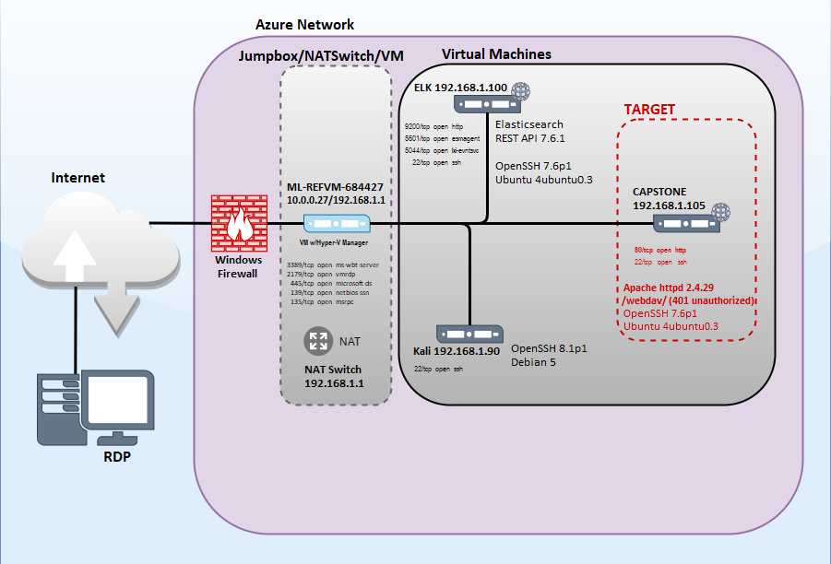
Network Topology
Network
Netmask: 255.255.255.0
Wildcard: 0.0.0.255
Network: 192.168.1.0/24
Broadcast: 192.168.1.255
HostMin: 192.168.1.1
HostMax: 192.168.1.254
Hosts/Net: 254
(Private Internet Class C)
Gateway: 192.168.1.1
Machines
IPv4: 192.168.1.1
OS: Windows
Hostname: ML-REFVM-684427
IPv4: 192.168.1.90
OS: Linux
Hostname: Kali
IPv4: 192.168.1.100
OS: Linux
Hostname: ELK
IPv4: 192.168.1.105
OS: Linux
Hostname: Capstone

Slide 5

Red Team
Security Assessment
5

Slide 6
Recon: Describing the Target
Nmap identified the following hosts on the network:
Hostname | IP Address | Role on Network
Capstone | 192.168.1.105 | Web Server
ELK | 192.168.1.100 | Monitoring System
Kali | 192.168.1.90 | Penetration Testing System
ML-REFVM-684427 | 192.168.1.1 | NATSwitch

Slide 7
Vulnerability Assessment
The assessment uncovered the following critical vulnerabilities in the target:
Vulnerability | Description | Impact
Security Misconfiguration - Directory Listing Enabled on Apache Web Server | Directory structure and files on the Capstone Apache web server are fully exposed. | Files revealed user “ashton” is the administrator for the directory: /company_folders/secret_folder/
Brute Force Vulnerability - Weak Password/No Failed Password Lockout | No lockout for failed login attempts allows for brute force attacks. Weak password cracked via Hydra dictionary/brute force attack. | Brute force provided access to: /secret_folder/ password hash for Ryan exposed -> dav://192.168.1.105/webdav/
Remote Code Execution | Web server IPS/IDS/Firewall(s) allows outbound ports and undetected reverse shell payloads. | Gained remote backdoor shell access to Capstone Apache web server. Data breached. Flag found.

Slide 8
Exploitation: Security Misconfiguration
01
02
03
Tools & Processes
dirb to locate URLs on the target site.
Browser to explore 192.168.1.105/
Achievements
The exploit revealed the following directories:
/secret_folder
/webdav
Reviewed files to determine further reconnaissance.
Exploitation
The login prompt reveals admin username “ashton” for directory:
/company_folders/secret_folder
This directory is password protected, but susceptible to brute-force attacks…

Slide 9
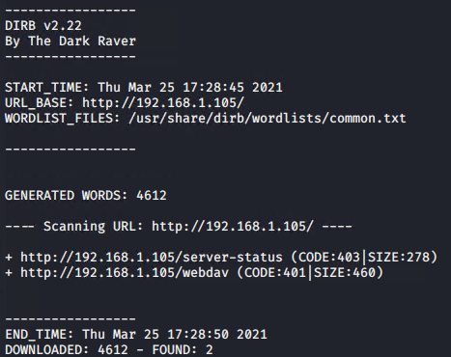
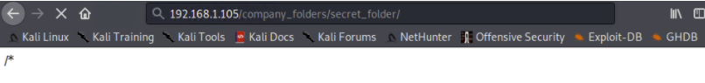
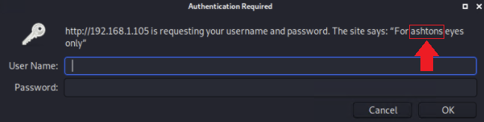
Exploitation: Security Misconfiguration (Cont.)
Utilized dirb to locate
URLs on the target site
Recon: 192.168.1.105/webdav
The login prompt reveals admin username “ashton” for 192.168.1.105/company_folders/secret_folder/

Slide 10
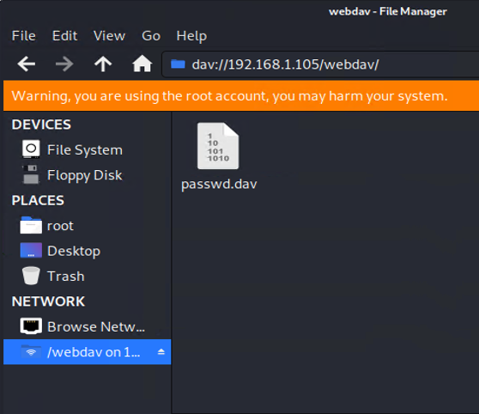
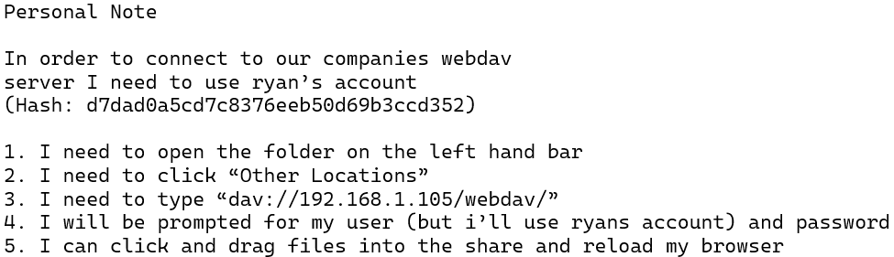
Exploitation: Brute Force - Password
01
02
03
Tools & Processes
Hydra brute force dictionary attack.
https://Crackstation.net to crack user Ryan’s hashed password.
Achievements
Password for user Ashton was cracked via dictionary attack in Hydra.
Accessed the /secret_folder/ directory with cracked credentials.
Access info for /webdav/ directory was found.
Hash for Ryan’s password was found and cracked, allowing access to /webdav.
linux4u

Slide 11
Exploitation: Remote Code Execution
01
02
03
Tools & Processes
1. Created msfvenom payload:
php/meterpreter/reverse_tcp
2. Uploaded shell exploit to target.
3. Established remote listener via msfconsole on port 4444 and ran exploit.
4. Executed reverse shell backdoor on Capstone Apache server.
Achievements
Opened a remote backdoor shell to the Capstone Apache server and gained access to the root directory on the Capstone server (192.168.1.105).
Found hidden flag.txt file.
Proof of Exploit
meterpreter > shell
find / -iname flag.txt 2>/dev/null
results: /flag.txt
cd /
cat flag.txt :
b1ng0w@5h1sn@m0

Slide 12
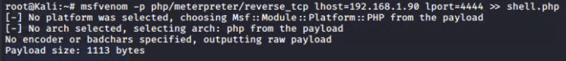
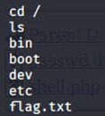
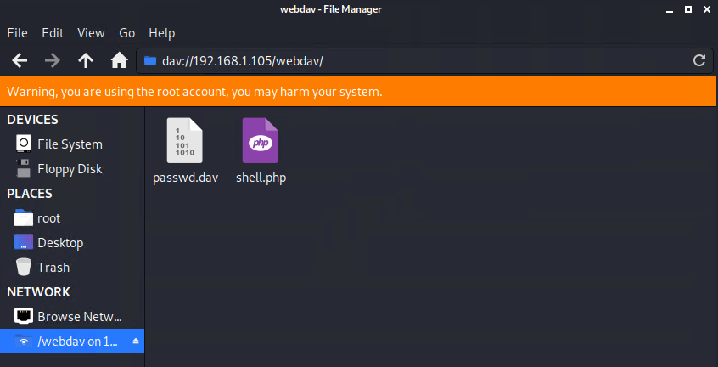
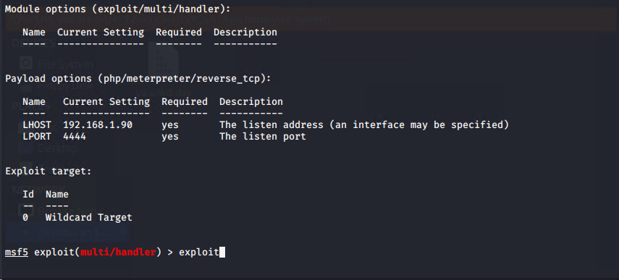
Exploitation: Remote Code Execution (Cont.)
4
1
Reverse shelled into the system & revealed the file contents of flag.txt:
2
3
Created payload file ‘shell.php’ which is the reverse shell payload, a plain php script that is configured according to the LHOST and LPORT parameters.

Slide 13

Blue Team
Log Analysis and Attack Characterization
13

Slide 14
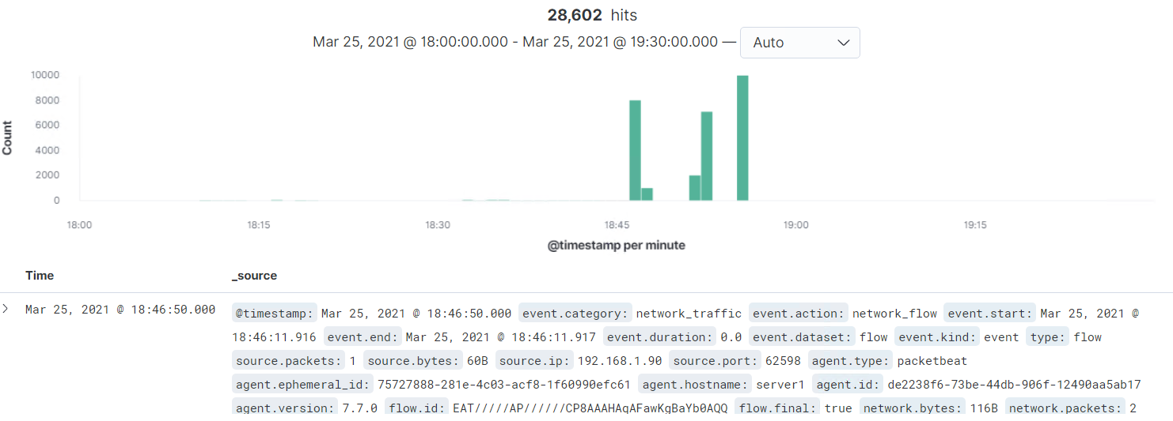
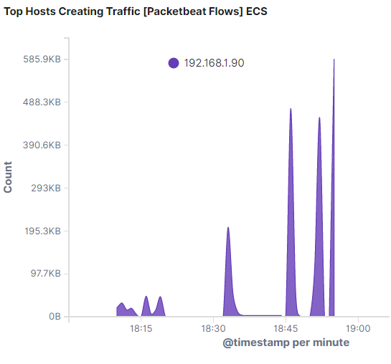
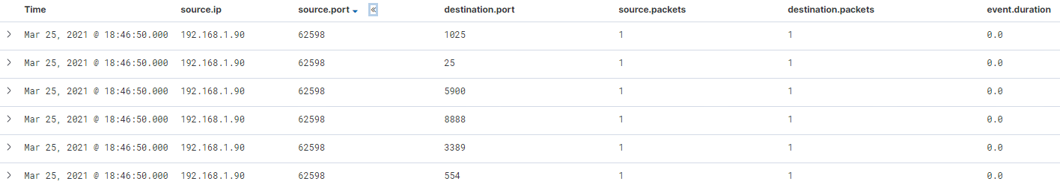
Analysis: Identifying the Port Scan
Multiple port requests at the same time indicate port scanning activity.
The port scan performed by 192.168.1.90 began @ 18:46:50.000
The sudden spike in network traffic and requests is indicative of a port scan against the network.
Performed multiple port scans, for a total of 28,468 hits.
The source of the increased network traffic is IP 192.168.1.90

Slide 15
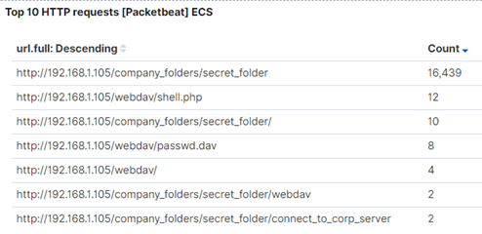
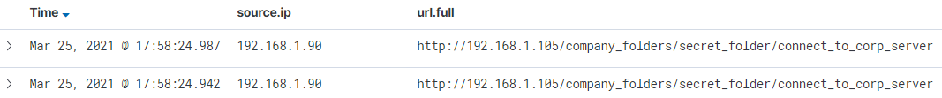
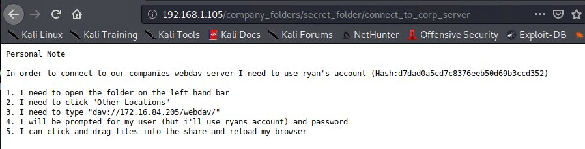
Analysis: Finding the Request for the Hidden Directory
The /connect_to_corp_server directory was requested, but was only accessed 2 times.
This page contains instructions for connecting to the /webdav directory.
The request for the hidden directory occurred on March 25, 2021 @ 17:58:24.942
There were 16,439 requests made. Most requests originated from the brute force attack performed.

Slide 16
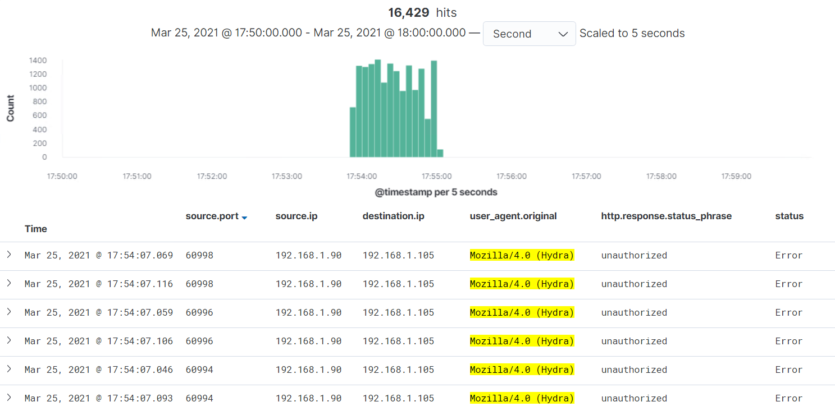
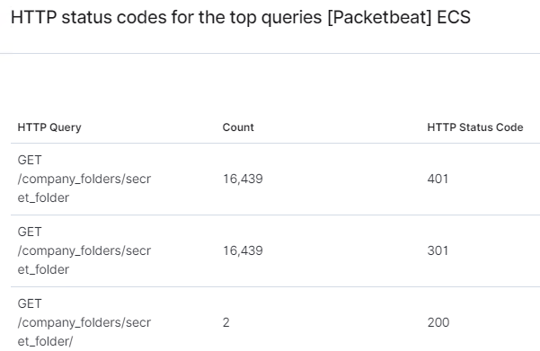
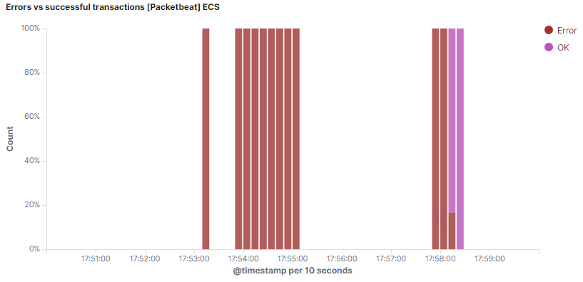
Analysis: Uncovering the Brute Force Attack
16,439 requests were made to the password protected folder: /company_folders/secret_folder
The logs contain evidence of a large number of requests for the sensitive data. Only 2 requests were successful.
This is indicative of a brute force attack.

Slide 17
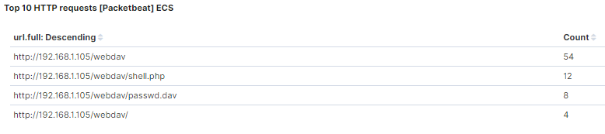
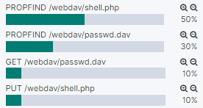
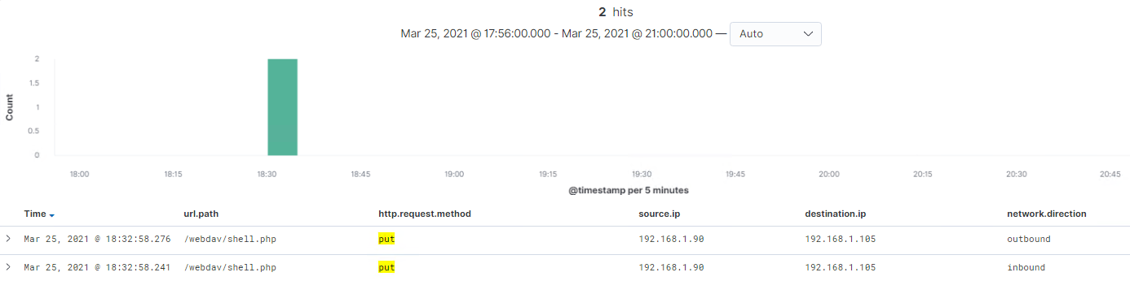
Analysis: Finding the WebDAV Connection
Fig. 1
Fig. 2
Fig. 3
54 requests were made to the /webdav/ directory (Fig. 1)
Request methods breakdown; note “PUT” method (Fig. 2)
Files requested and frequency shown in (Fig. 1)
Backdoor payload shell.php was uploaded on
March 25, 2021 @ 18:32:58.241 (Fig. 3)

Slide 18
Blue Team
Proposed Alarms and Mitigation Strategies
18

Slide 19
Mitigation: Blocking the Port Scan
Alarm Criteria
Number of ports accessed per source IP per second.
Threshold Criteria
Trigger alert to email and log incidents when > 3 port scans are detected (≠ ports 80, 443) at the same time from any single IP address.
Trigger alert to email and log incidents when IP address sends > 10 requests per second for more than 5 seconds
Block/Forward (honeypot) | delay port scans (web server)
RULES IPTABLES (Example)
iptables -N LOGPSCAN
iptables -A LOGPSCAN -p tcp --syn -m limit --limit 2000/hour -j RETURN
iptables -A LOGPSCAN -m limit --limit 200/hour -j LOG --log-prefix "DROPPED Port scan: "
iptables -A LOGPSCAN -j DROP
iptables -A INPUT -p tcp --syn -j LOGPSCAN
Filter ICMP traffic.
Whitelist internal IP addresses to detect future unauthorized access.
Firewall block all incoming and outgoing ports except for those needed (80 and 443).
Implementing IPTables/Firewall port block and scan delay is an effective mitigation technique to stop unwanted port scanning. Utilizing an IDS/IPS like Splunk will effectively alert and facilitate rapid response to potential threats.

Slide 20
Mitigation: Finding the Request for the Hidden Directory
Alarm Criteria
Whitelist internal IP addresses to detect future unauthorized access.
Set an alert for any external IP addresses attempting connection.
Threshold Criteria
Trigger alert to email and log incidents when unauthorized IP access > 0
Example: Alert email and log when > 0 access is detected on “secret_folder” from IPs other than 192.168.1.105 or 192.168.1.1
Modify the httpd.conf file on the host to block unwanted access to “secret_folder” from any IP other than those listed:
Open httpd.conf file
nano /etc/httpd/conf/httpd.conf
Locate directory section (/var/www/) & set the following rules:
<Directory /var/www/company_folders/secret_folder/>
Order allow,deny
Allow from 192.168.1.1
Allow from 192.168.1.105
Deny from 192.168.1.90
</Directory>
Disable directory listing in apache
Data should be encrypted at rest.

Slide 21
Mitigation: Preventing Brute Force Attacks
Alert Criteria
# of Requests per Second
# of Error (200, 401) responses detected per 5 seconds
Threshold Criteria
Trigger alert to email and log incidents when > 100 requests per second for 5 seconds.
Trigger alert to email and log incidents when requests for protected files and folders respond with > 5 Error (401) responses; OR any OK (200) responses occur from external IPs
The best defense against hackers is a strong password. Always use at least 9 characters. The longer the password, the more difficult it is to attack with a "brute-force“.
Implement a lockout policy, locking out multiple failed login attempts in order to mitigate against brute force attacks.
Implement multi-factor authentication.
Ask users to answer a security response upon multiple failed logins.
Use a CAPTCHA to ensure the user is human.

Slide 22
Mitigation: Detecting the WebDAV Connection
Alert Criteria
Number of times the /webdav directory is requested/read by unauthorized IPs.
Threshold Criteria
Trigger alert to email and log incidents when ANY requests are made for the /webdav directory by unauthorized IPs.
Modify the httpd.conf file on the host to block unwanted access to the /webdav directory from any IP other than those listed:
Open httpd.conf file
nano /etc/httpd/conf/httpd.conf
Locate directory section (/var/www/) & set the following rules:
<Directory /var/www/webdav/>
Order allow,deny
Allow from 192.168.1.1
Allow from 192.168.1.105
Deny from all
</Directory>
Configure Filebeat on the host to Monitor access to the /webdav directory.

Slide 23
Mitigation: Identifying Reverse Shell Uploads
Alert Criteria
# of POST requests containing form or file data of a disallowed file type, e.g., .php.
Threshold Criteria
Trigger alert to email and log incidents when ANY user uploads a forbidden file type.
Filebeat should be enabled and configured to monitor HTTP methods.
Restrict write permissions on the host.
Deny all POST requests with a root .httaccess file:
# deny all POST requests
<IfModule mod_rewrite.c>
RewriteCond %{REQUEST_METHOD} POST
RewriteRule .* /custom.php [R=301,L] ← Redirect
</IfModule>

